Slide 1
Return attribution
november 2024
Charlie Nash
Head of QRA
Alan Cubbon
Head of Research

Slide 2
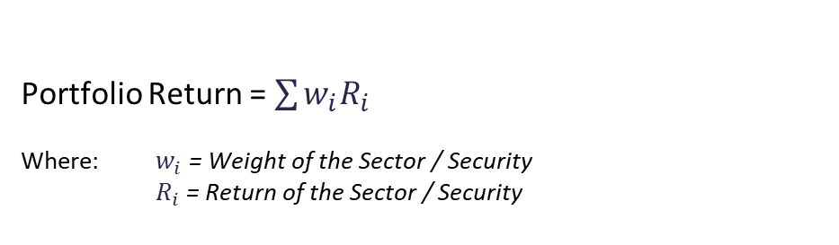
Return Contribution analysis
Known as absolute return attribution analysis as it is not calculated relative to a benchmark
Portfolio Return = $\sum{w_{i}R_{i}}$
Where: $w_{i}$ = Weight of the Sector / Security
$R_{i}$ = Return of the Sector / Security
Example:
 | Weight % | Return % | Contribution %
Security A | 25 | 4.80 | 1.20
Security B | 50 | 2.50 | 1.25
Security C | 25 | -1.20 | -0.30
Portfolio Total | 100 | 2.15 | 2.15
Source: CAIM, November 2024

Slide 3
Attribution Analysis
Quantifies the portfolio manager’s active decisions to explain the difference between the portfolio and benchmark returns
Allocation = Refers to the value the portfolio manager adds by having different sector weights
Selection = Refers to the value the portfolio manager adds by holding individual securities within the sector
Sector | Portfolio weight % | Portfolio return % | Benchmark weight % | Benchmark return % | Allocation % | Selection %
Government | 50 | 18 | 50 | 10 | 0.00 | 4.00
Financial | 30 | -3 | 20 | -2 | -1.02 | -0.30
Cash | 20 | 10 | 30 | 12 | 0.38 | -0.40
Portfolio Total | 100 | 10.1 | 100 | 8.2 | -1.40 | 3.30
What does this tell us?
Overall, the fund outperformed the benchmark by 1.9%
The portfolio is overweight financials and underweight cash (10%)
Being overweight financials cost 1%, and selection within financials also had a negative effect
Being neutral governments had no effect, but the selection within this sector had a strongly positive effect
Source: CAIM, November 2024

Slide 4
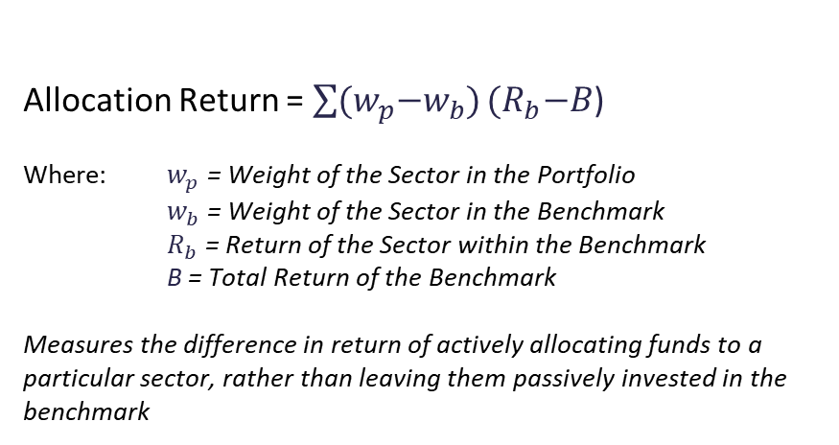
Attribution Analysis
Allocation Calculation
Allocation Return = $\sum{{(w}_{p}−w_{b})}{(R}_{b}−B$)
Where: $w_{p}$ = Weight of the Sector in the Portfolio
$w_{b}$ = Weight of the Sector in the Benchmark
$R_{b}$ = Return of the Sector within the Benchmark
B = Total Return of the Benchmark
Measures the difference in return of actively allocating funds to a particular sector, rather than leaving them passively invested in the benchmark
Sector | Portfolio weight % | Portfolio return % | Benchmark weight % | Benchmark return % | Allocation %
Government | 50 | 18 | 50 | 10 | (50 – 50) x (10 – 8.2) = 0.0
Financial | 30 | -3 | 20 | -2 | (30 – 20) x (-2 – 8.2) = -1.0
Cash | 20 | 10 | 30 | 12 | (20 – 30) x (12 – 8.2) = -0.4
Portfolio Total | 100 | 10.1 | 100 | 8.2 | 0.0 + -1.0 + -0.4 = -1.4
Source: CAIM, November 2024

Slide 5
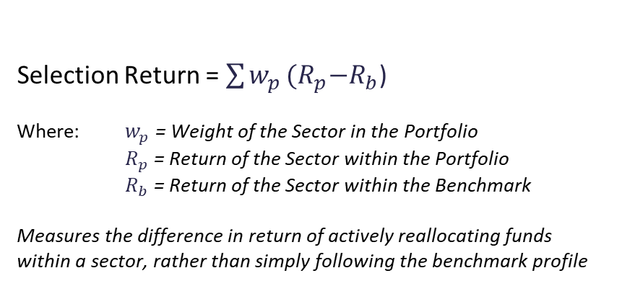
Attribution Analysis
Selection Calculation
Selection Return = $\sum{w_{p}}{(R}_{p}−R_{b}$)
Where: $w_{p}$ = Weight of the Sector in the Portfolio
$R_{p}$ = Return of the Sector within the Portfolio
$R_{b}$ = Return of the Sector within the Benchmark
Measures the difference in return of actively reallocating funds within a sector, rather than simply following the benchmark profile
Sector | Portfolio weight % | Portfolio return % | Benchmark weight % | Benchmark return % | Selection %
Government | 50 | 18 | 50 | 10 | 50 x (18 – 10) = 4.0
Financial | 30 | -3 | 20 | -2 | 30 x (-3 – -2) = -0.3
Cash | 20 | 10 | 30 | 12 | 20 x (10 – 12) = -0.4
Portfolio Total | 100 | 10.1 | 100 | 8.2 | 4.0 + -0.3 + -0.4 = 3.3
Source: CAIM, November 2024

Slide 6
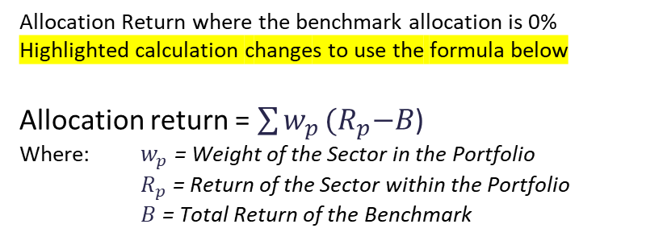
Attribution Analysis – Off-Benchmark Bets
Allocation Calculation – for sectors not included in the benchmark
Allocation Return where the benchmark allocation is 0%
Highlighted calculation changes to use the formula below
Allocation return = $\sum{w_{p}}{(R}_{p}−B$)
Where: $w_{p}$ = Weight of the Sector in the Portfolio
$R_{p}$ = Return of the Sector within the Portfolio
$B$ = Total Return of the Benchmark
Sector | Portfolio weight % | Portfolio return % | Benchmark weight % | Benchmark return % | Allocation %
Government | 50 | 18 | 50 | 10 | (50 – 50) x (10 – 8.2) = 0.0
Financial | 25 | -3 | 20 | -2 | (25 – 20) x (-2 – 8.2) = -0.5
Transportation | 5 | 4 | - | - | (5) X (4 – 8.2) = -0.2
Cash | 20 | 10 | 30 | 12 | (20 – 30) x (12 – 8.2) = -0.4
Portfolio Total | 100 | 10.5 | 100 | 8.2 | 0.0 + -0.5 + -0.2 + -0.4 = -1.1
Source: CAIM, November 2024

Slide 7
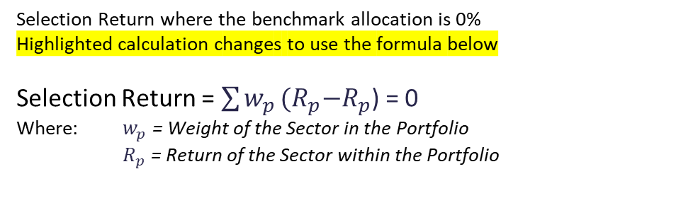
Attribution Analysis – Off-Benchmark Bets
Selection Calculation – for sectors not included in the benchmark = 0
Selection Return where the benchmark allocation is 0%
Highlighted calculation changes to use the formula below
Selection Return = $\sum{w_{p}}{(R}_{p}−R_{p}$) = 0
Where: $w_{p}$ = Weight of the Sector in the Portfolio
$R_{p}$ = Return of the Sector within the Portfolio
Sector | Portfolio weight % | Portfolio return % | Benchmark weight % | Benchmark return % | Selection %
Government | 50 | 18 | 50 | 10 | 50 x (18 – 10) = 4.0
Financial | 25 | -3 | 20 | -2 | 25 x (-3 – -2) = -0.25
Transportation | 5 | 4 | - | - | 5 x (4 – 4) = 0
Cash | 20 | 10 | 30 | 12 | 20 x (10 – 12) = -0.4
Portfolio Total | 100 | 10.5 | 100 | 8.2 | 4.0 + -0.3 + 0 + -0.4 = 3.4
Alpha = 10.5% - 8.2% = 2.3%
Allocation + Selection = -1.1% + 3.4% = 2.3%
Source: CAIM, November 2024

Slide 8
Attribution Analysis – another example
Analysis by maturity bucket
Maturity | Portfolio weight % | Portfolio return % | Benchmark weight % | Benchmark return % | Allocation % | Selection %
0 – 1 Year | 20 | 0.15 | 20 | 0.14 | 0.00 | 0.00
1 – 3 Years | 50 | 1.65 | 30 | 1.55 | -0.08 | 0.05
4 – 9 Years | 20 | 2.80 | 30 | 2.75 | -0.08 | 0.01
10+ Years | 10 | 3.35 | 20 | 3.25 | -0.13 | 0.01
Total | 100 | 1.75 | 100 | 1.97 | -0.29 | 0.07
Portfolio manager decisions:
Overweighting of shorter maturity segments of the yield curve.
Evident in the overweighting of the 1-3 year bucket vs 4-9 years and 10+ years.
Anticipation of interest rate rise across maturities.
Underweighting of longer maturities would have limited losses from rising rates.
Analysis suggests manager was incorrect in this underweighting, as allocation for buckets over 1 year are contributing to the overall loss.
Allocation covers yield curve positioning. Selection covers all other decisions.
Source: CAIM, November 2024

Slide 9
Attribution GAME
First scenario: “Risk On”
Global growth stable with risks skewed to the upside
Bearing this in mind, from the “Benchmark” worksheet choose up to 10 bonds to include in your portfolio by entering a “1” in the first column, next to your chosen bonds.
In the “Portfolio” sheet enter the weights you wish to allocate to these bonds. These must sum to 100%, and going short (negative weights) are not allowed.
Returns, contributions and performance figures will remain zero.
At the end of the game we enter the password and click button “1”. At this point all the returns etc. are populated and we can see how our portfolio performed, relative to the benchmark.
Highest alpha wins!

Slide 10
Attribution GAME
Second scenario: “Risk Off”
Global growth expectation revised downward with increased risks of severe credit downgrades expected in the sovereign and corporate space
Use the “Reset Scenario” button to put all returns back to zero.
As before, select up to 10 bonds from the “Benchmark” worksheet, and enter the weights you wish to allocate to these bonds in the “Portfolio” sheet.
At the end of the game we enter a new password and click button “2”.
Again: highest alpha wins!

